Slide 1
EENG 284 Lab 6
Calculator with Friendly Display
Notes:
Usually the <title of the lab> is what will be called the “System” through the rest of this document

Slide 2
Lab Objectives
Calculator that can
add/sub 4-bit values
unsigned and signed
Display as decimal digital
Logic
2’s complement numbering
Arithmetic circuit elements
Verilog
Simulation
Synthesis

Slide 3
Lab 06:Adder/Subtractor w/ decimal display
Build a basic calculator that can add or subtract 4-bit values.
Connect slide switches to the x and y inputs of an adder/ subtractor which sends its output to a seven-segment display.
You will display the inputs and output as 2-digit decimal values.
The user enters a pair of 4-bit operands using the left-most slide switches, xSlide and ySlide.
The value entered for xSlide and ySlide is displayed on two seven-segment displays each.
3

Slide 4
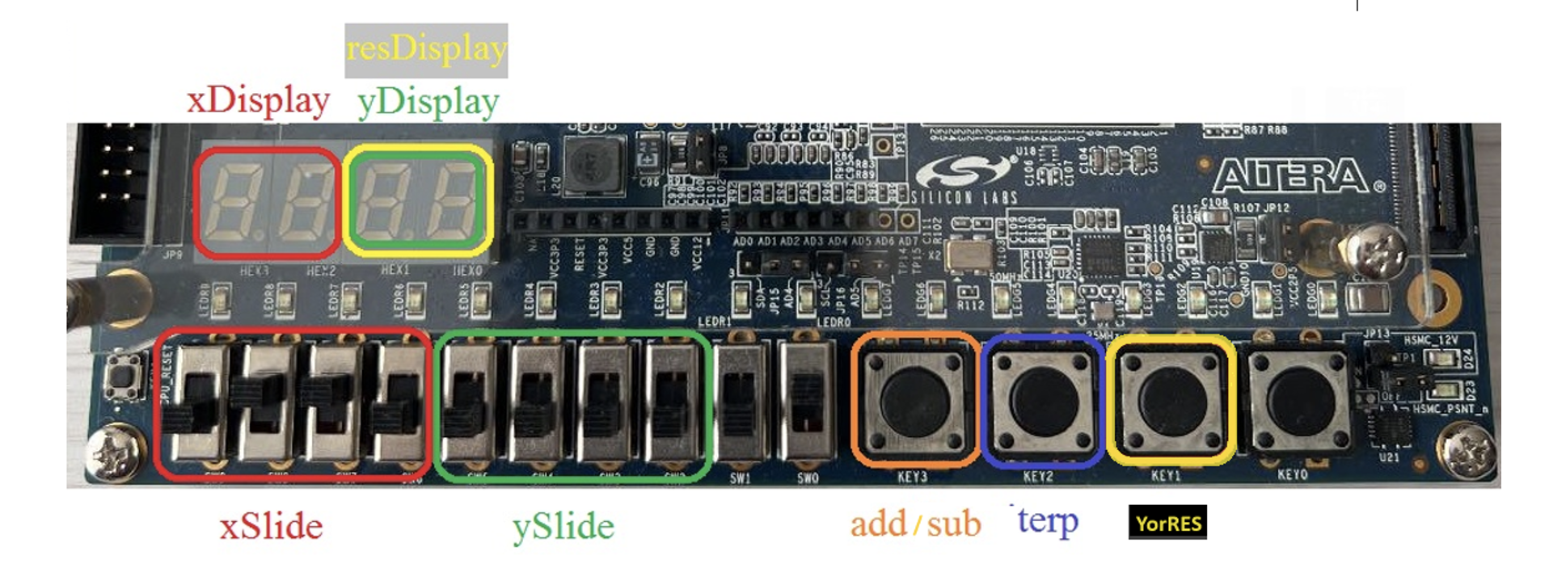
Operation
The leftmost button, add/Sub, specifies the operation performed on xSlide and ySlide.
When the button is unpressed the result is (xSlide + ySlide) and if the button is pressed, the result is (xSlide – ySlide).
The interp button determines how the values are displayed on the seven-segment display.
When the button is unpressed decimal values are displayed, and if the button is pressed, 2’s complement id displayed.
4

Slide 5
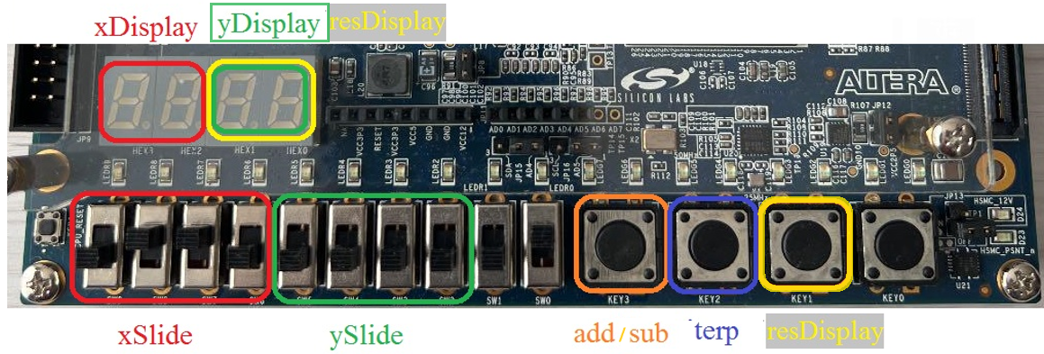
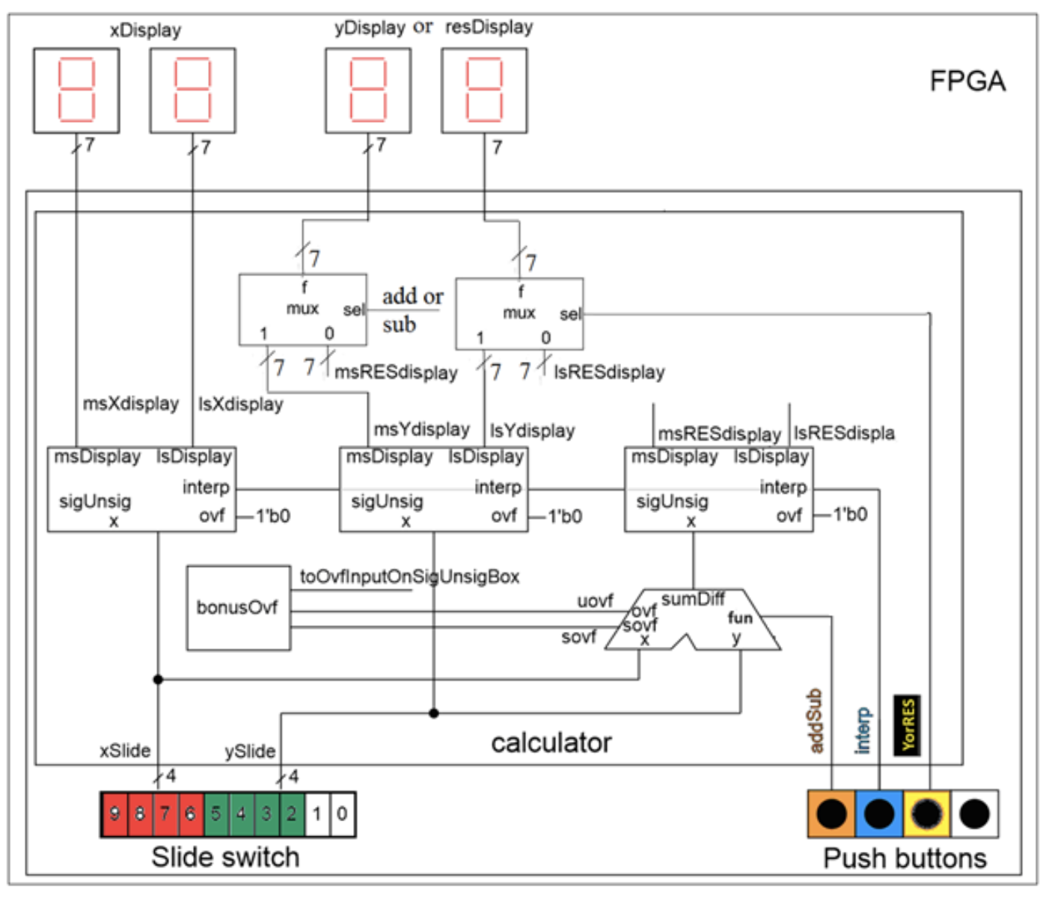
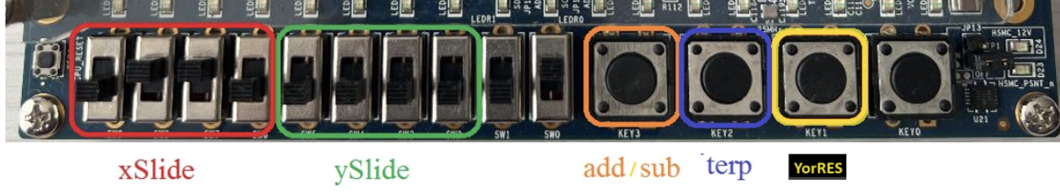
System Architecture
5
Notes:
Lines with the same name are connected together. For example, the rand button input is connected to the 2:1 mux in the upper left corner of the FPGA.
When a signal is sent to multiple devices in close proximity, a grey line is used to show that the signal is “underneath a device. For example, the rand signal is sent to the select input of both 2:1 muxes in the upper left corner of the schematic. These unconnected connections are called “air-wires.”
The input signals are color-coded to correspond to the colors used in Figure 1.

Slide 6
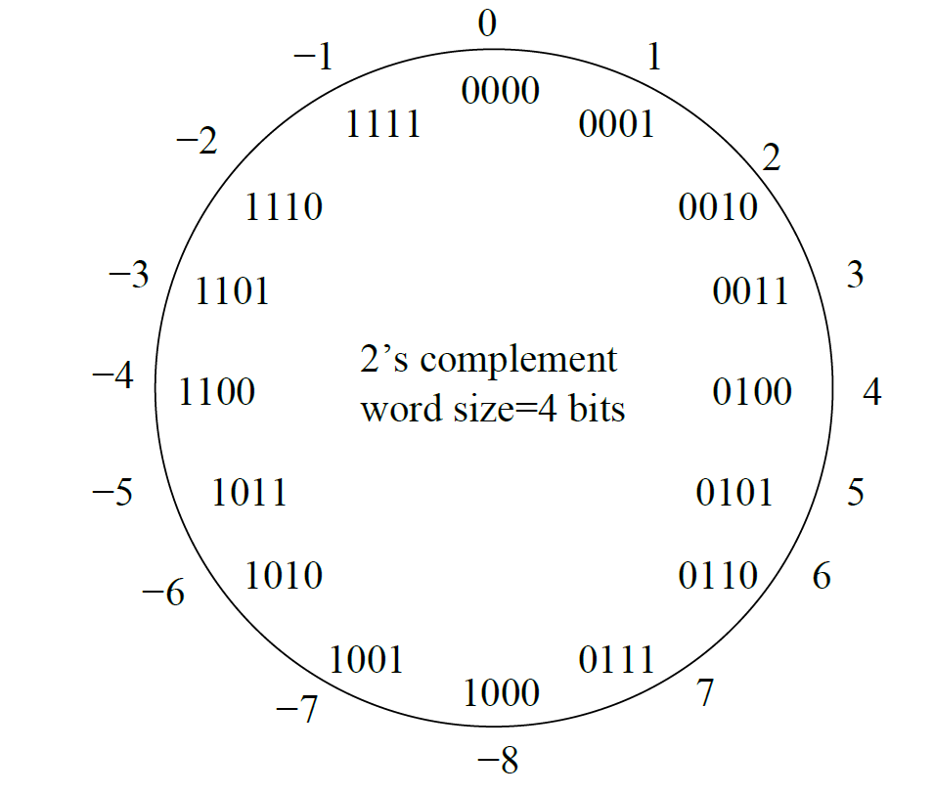
2’s complement
Bits do not have meaning
Bits have interpretations
Interpretations give bits value

Slide 7
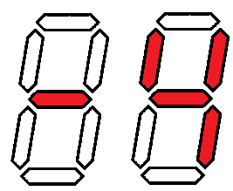
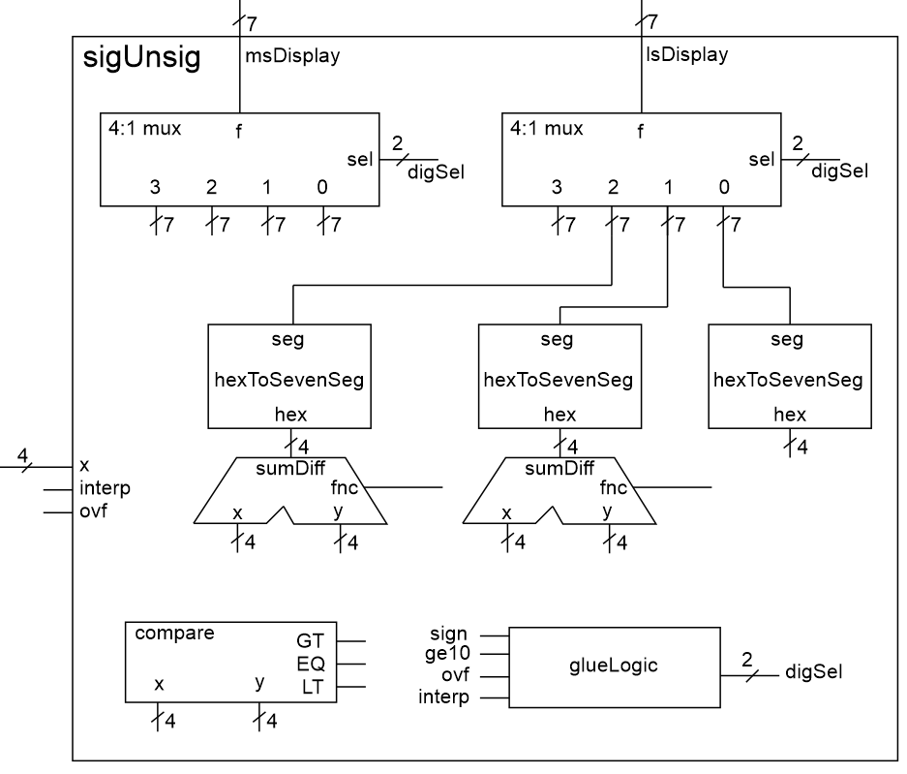
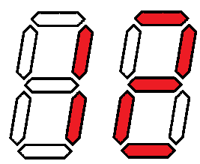
sigUnsig Module
x=4’b1100
interp = 1
x=4’b1100
interp = 0
7
Notes:
Lines with the same name are connected together. For example, the rand button input is connected to the 2:1 mux in the upper left corner of the FPGA.
When a signal is sent to multiple devices in close proximity, a grey line is used to show that the signal is “underneath a device. For example, the rand signal is sent to the select input of both 2:1 muxes in the upper left corner of the schematic. These unconnected connections are called “air-wires.”
The input signals are color-coded to correspond to the colors used in Figure 1.

Slide 8
Deliverables
signUnsig Module:
Complete Tables 6.1, 6.2 and 6.3.
Complete the code in Listing 6.2.
Complete Figure 6.4, including:
Constant values on inputs of 4:1 mux
Constant value on the input of the right-most hexToSeventSeg
Value on the input of the adder subtractors
Values on the input of the comparator
Verilog code for the body of the sigUnsig module (courier 8-point font single spaced), leave out header comments.
Testbench
Complete testbench and timing diagram from Section 6.5.
Pin-Assignment and Synthesis
Complete the pin assignment in table
Demonstrate your circuit to a member of the lab team.

